Slide 1
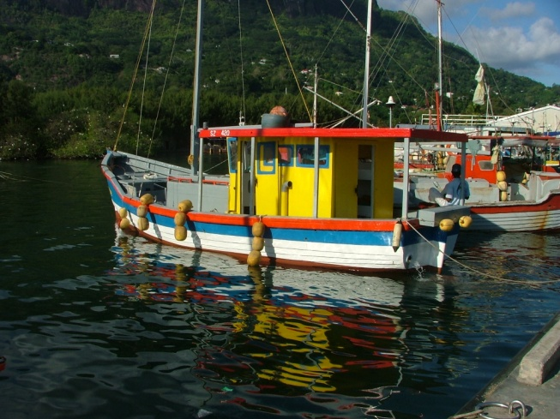
Participatory Mapping 2 October 2014
Seychelles Marine Spatial Planning Initiative
22-23 October 2014
Technical Working Group Meeting #2

Slide 2
Getting started with GeoPDF
Review data layers available by zone type
Review mapping from August 2014
Gather revised planning tools:
Compatibility matrix
Master List
Table of 5 Zone types
Organise input into Inner Islands and 5 Outer Islands groups

Slide 3
Participatory Mapping
SOCIO-ECONOMIC
Where are the “best areas” for current uses?
Where are possible “best areas” for future uses?
What are compatible uses that currently occur in this area? What are conflicting uses?
Where are the “must have” areas?
Climate change: sea level rise, coastal inundation?
Seasonal influences?

Slide 4
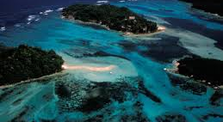
Questions

