Slide 1
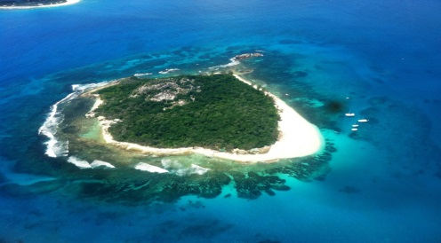
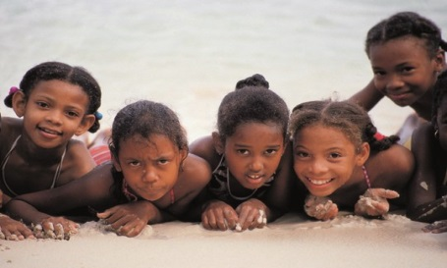
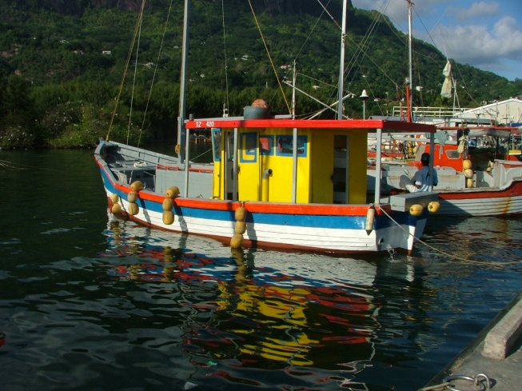
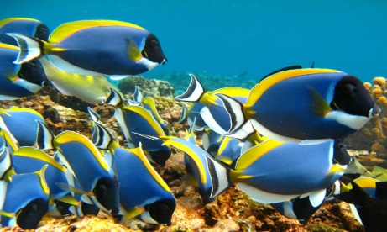
Draft Zoning Proposal
Seychelles Marine Spatial Planning Initiative
5 August 2014
Steering Committee Meeting #1

Slide 2
Marine Spatial Planning
A public process of analysing and allocating the spatial and temporal distribution of human activities in marine areas to achieve ecological, economic, and social objectives that are usually specified through a political process.
Ehler, C. and F. Douvere. 2009. Marine spatial planning: a step-by-step approach toward ecosystem-based management.

Slide 3
Marine zoning
Method to delineate areas of the coastal and marine environment for specific activities in time and/or space.
Supports marine spatial planning objectives
Legislated and regulated
Policy guidance and management plans
Agardy, T. 2010. Ocean Zoning: Making ocean management more effective. Routledge. 240 pp.
Notes:
Zoning. Definition of zoning is taken from Tundi Agardy's 2010 book. Zoning already exists in the ocean, as folks know. Zoning is familiar to people on land. It is a method to allocate space and in the context of marine spatial planning, is intended to achieve several benefits. Zoning supports marine spatial planning objectives. Some zoning is regulatory and regulated by laws. Other times, zoning develops policy guidance.

Slide 4
Zoning Benefits to Marine Governance
Protect sensitive or vulnerable ecosystem types
Conserve heritage and cultural areas
Increase certainty for existing uses and activities
Reduce or minimise conflicts between marine users
Plan for new or future economic activities
Clear policy guidance for resource managers
Build efficiencies in marine-use decisions
Notes:
Benefits. There are numerous benefits to zoning, and these are just a few. [can read out a few of the benefits]. Take home message is that zoning in the context of marine spatial planning would address multiple objectives (i.e., ecological, economic, social, cultural, governance).

Slide 5
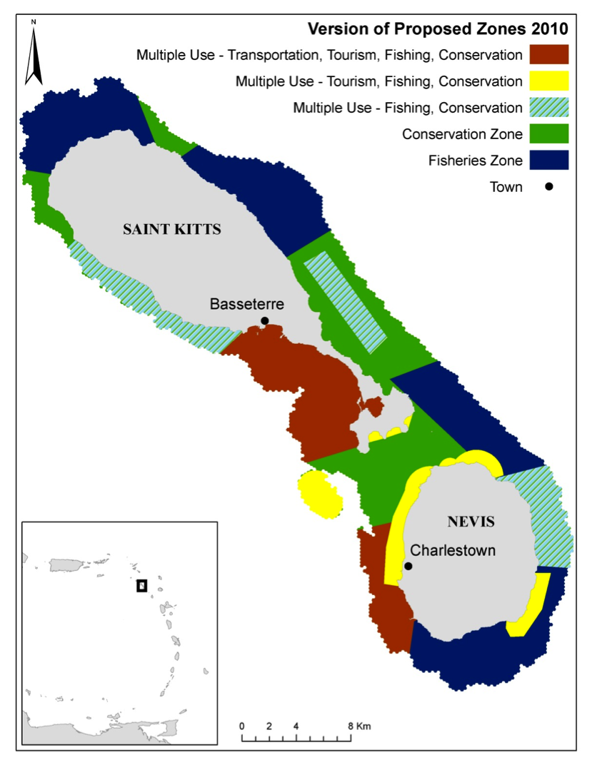
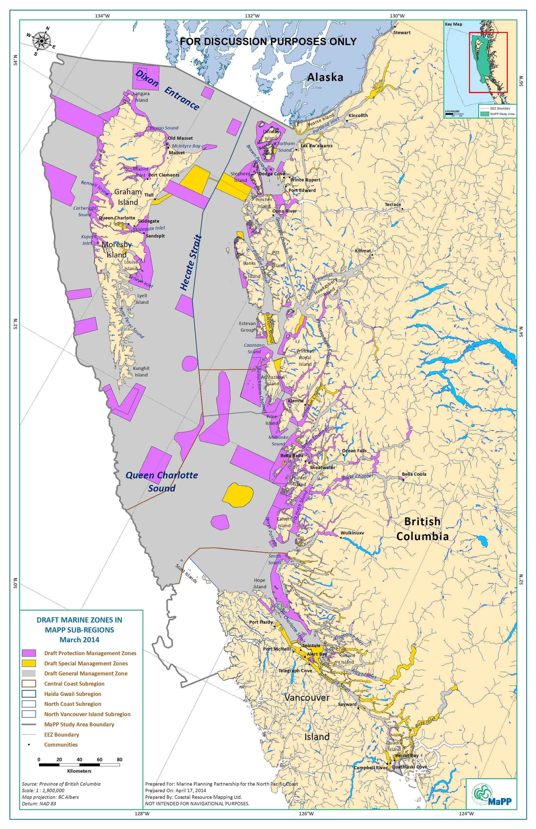
Zoning Examples
St. Kitts and Nevis, Caribbean
North Coast British Columbia, Canada
Source: Agostini et al. 2014
Source: Marine Planning Partnership 2014
Notes:
St Kitts and Nevis
Pros: two zones for uses identify the primary activity or use: 1) Fishing, and 2) Conservation
Cons: three of the multi-use zones have overlapping uses and no clear objective that differentiates them. What is different about multi-use red, yellow and green/stripe?
North Coast BC
Pros: Each zone has a distinct name
Cons: The names are ambiguous or vague and don’t tell you very much about the objective or purpose of the zone (General Management Zone, Special Management Zone)

Slide 6
DRAFT Zoning Process for Seychelles
Review existing plans, literature, guidelines
Review global “lessons learned”
Gather and review data layers
Zoning process
Scale and scope
Objectives
Approach, types and names
Criteria for defining the spatial extents
Develop spatial and non-spatial tools
Analyse information and data
Draft zones
Draft management objectives and direction
Define and Identify
Review
Assess
Adjust
Design

Slide 7
DRAFT Zoning Process for Seychelles
Review existing plans, literature, guidelines
Review global “lessons learned”
Gather and review data layers
Zoning process
Scale and scope
Objectives
Approach, types and names
Criteria for defining the spatial extents
Develop spatial and non-spatial tools
Analyse information and data
Draft zones
Draft management objectives and direction
July 2014 to June 2015

Slide 8
Developing Zoning Proposal
Descriptions of uses and activities
Information on existing zones, legislation, etc.
Examine historic patterns and status quo
Consider data availability
Consider future activities
Identify targeted uses and activities
Clearly identify objectives for each zone
Review and discuss

Slide 9
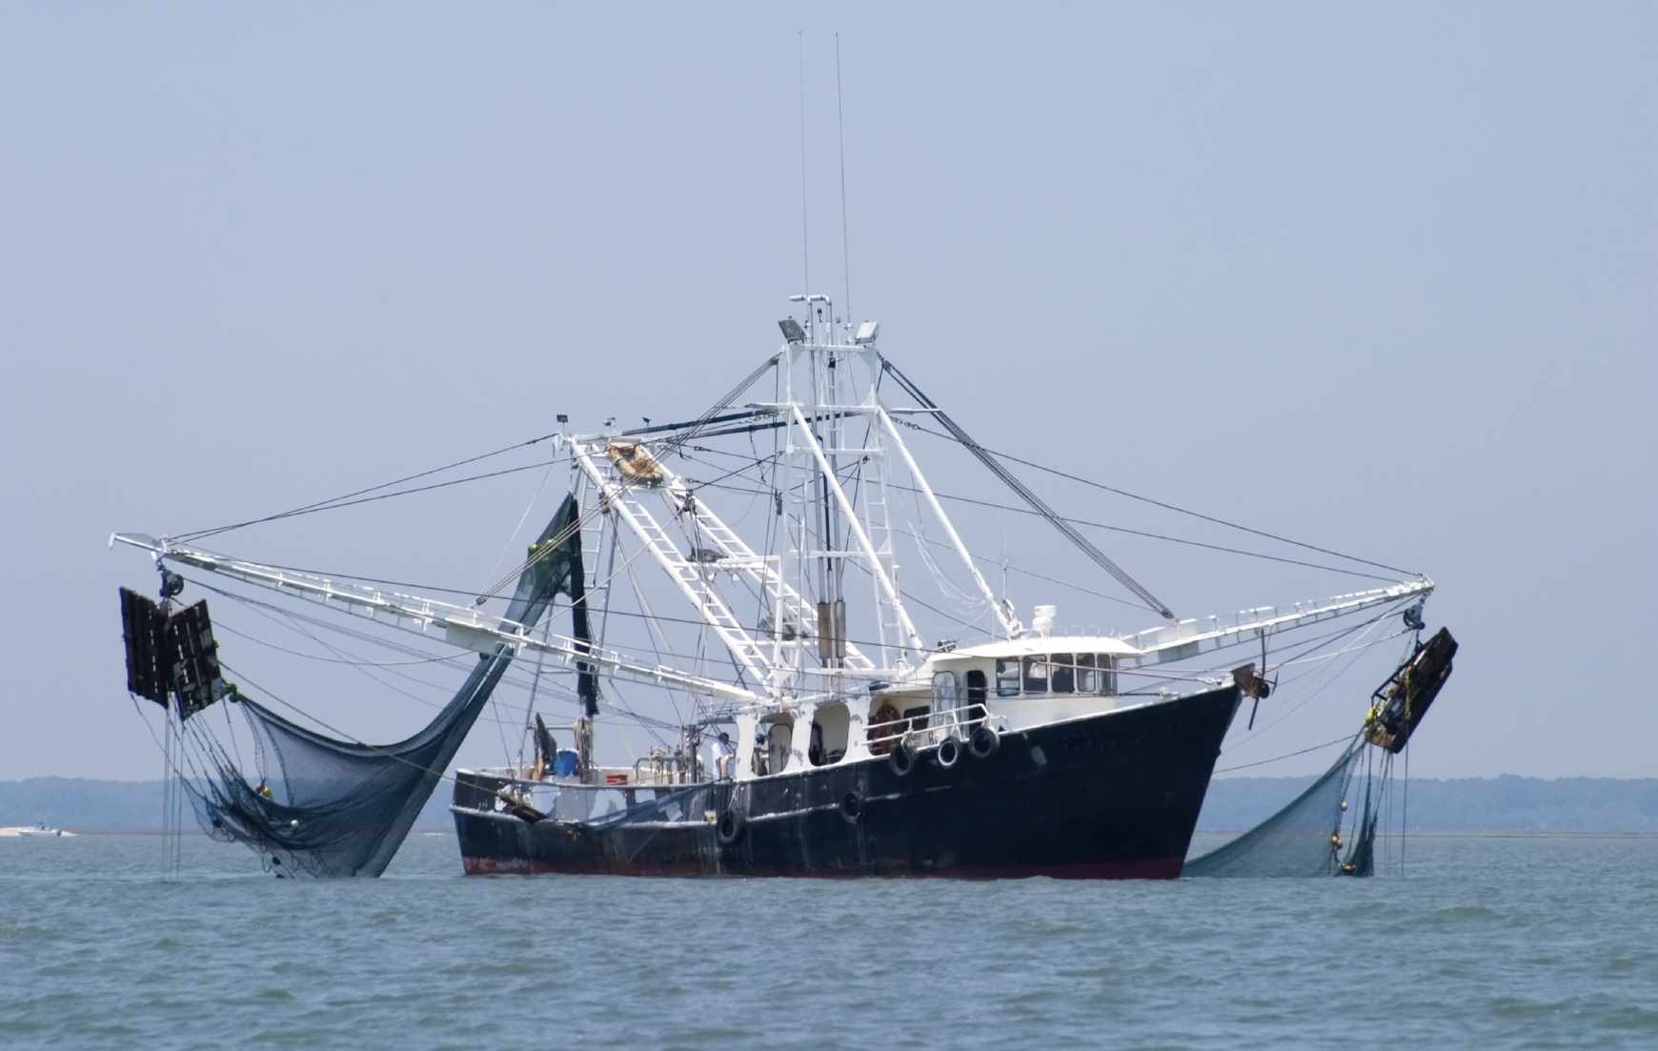
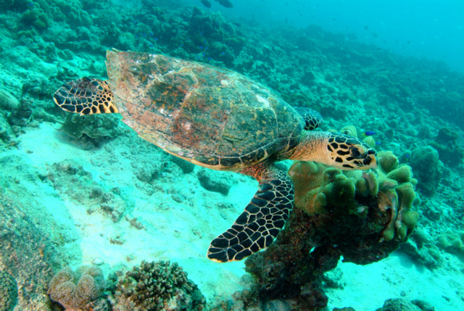
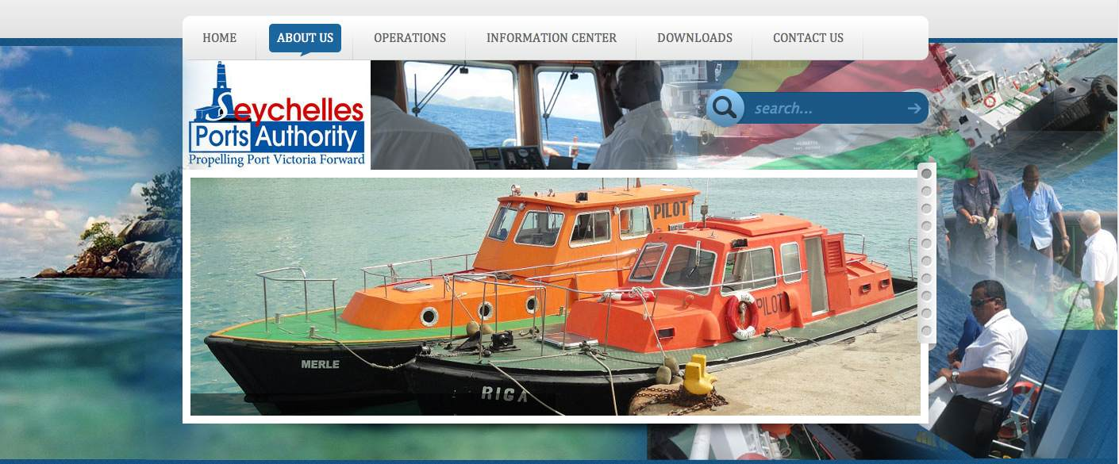
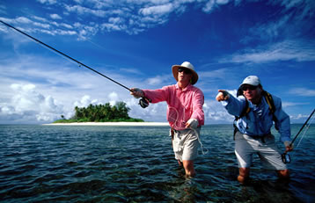
DRAFT Zone Types for Seychelles (with suggested names)
Zone A – Food Security - Fisheries
Zone B – Marine Protected Area
Zone C – Infrastructure & Services
Zone D – Non-Renewable Development
Zone E – Multi-Use Zone: Tourism, Recreation, Culture
Notes:
The proposed zoning approach for the Seychelles is to use "objective" based zoning (see Section 2). This approach is proposed for several reasons. Firstly, a use-based or ecologically-based approach both require quite a lot of data in order to delineate zones. At this point in the planning process, data layers for uses and activities are sparse thus it is not possible to allocate space based on specific uses. Secondly, the goal of the plan is for existing and future uses. By using a zoning approach that is flexible enough to include existing uses and possible future uses, zoning will be able to adapt over time. Finally, an objective-based approach clearly emphasises or identifies to the marine users, public, and resource managers the purpose of the zone. Management, enforcement and regulation of the zone can be mandated by the objective rather than be individual uses.

Slide 10
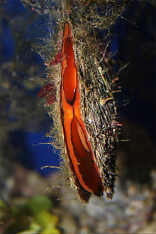
Zone A Food Security, Fisheries and Aquaculture
Primary objective: allocate space and guarantee access for food security, foreign exchange earning and income generation from fisheries
Targeted Uses: Fishing: industrial, semi-industrial, artisanal, aquaculture
Potential future uses: TBD
Considerations:
Fisheries management plans
International agreements
National Blue Economy policy
Fisheries replenishment zones
IUU fishing
Piracy
Photo: Safety4sea.com
Photo: wikipedia.com
Notes:
Zone A [insert name]
Suggested name: Food Security Zone
Other suggestion: Fisheries and Aquaculture Zone
The primary objective of this zone is to allocate space and guarantee access for food security, foreign exchange earning, and income generation from fisheries.
The objective provides business certainty now and in the future for fisheries and aims to minimise existing or future conflicts between fisheries and other marine uses or activities. The management plan for this zone is intended to be developed in conjunction with the Seychelles Fishing Authority fisheries management plans and be consistent with international agreements, laws and policies that pertain to fisheries in the Seychelles and Western Indian Ocean (e.g., Indian Ocean Tuna Commission, International Convention on Migratory Species, Blue Economy).
Sample Management conditions
Use would have a management plan in place, or being drafted, to demonstrate sustainability or commitment to the blue economy approach; use does not erode or destroy ecological integrity or ecosystem services
Compliance with all existing federal Acts, regulations and policies including permitting, licenses, and fees
Targeted uses:
Fishing - industrial (longline and purse seine)
Fishing - semi-industrial
Fishing - artisanal (trap, net, beach seine, handline, etc.)
Marine Aquaculture
etc.
Potential future uses
Fishing - new gear types or species
Marine Aquaculture - new species or locations
Compatible and/or Recommended Uses:
TBD
Considerations in developing this zone:
Fishing - recreation
IUU fishing (illegal, unreported, unregulated)
Piracy
distribution and mapping of migratory species
dynamic nature of fishing for pelagic species
overlap with conflicting uses
etc.

Slide 11
Zone B Marine Protected Area Zone, Biodiversity Zone
Primary objective: allocate space for conserving marine biological diversity and ecological processes - genes, species, populations and habitats .
Secondary objective: plan for climate change adaptation.
Targeted Uses: Biodiversity, cultural heritage, subsistence fisheries.
Potential future uses: Biotechnology, carbon sequestration, education, oxygenation, research
Considerations
Seychelles Conservation and Climate Adaptation process
GOS-UNDP-GEF Protected Area process
No-take areas
replenishment areas for fisheries
Ecosystem services
Photo: Tony Baskeyfield

Slide 12
Zone C Infrastructure Zone
Primary objective: allocate space for permanent and necessary marine infrastructure, defense, and public utilities that support people and marine economic activities in the Seychelles
Targeted Uses: disposal sites, ferries, maritime security, ports, shipping, telecommunications, waste management
Potential future uses: Renewable energy
Considerations:
Buffering for pollution or sedimentation
Sustainability programs used by port and other industry
Photo: Seychelles Port Authority

Slide 13
Zone D Non-renewable Zone
Primary objective: allocate space (identify the footprint) for non-renewable developments such as petroleum, natural gas and mining
Targeted Uses: petroleum exploration,, mining – minerals and aggregates,
Potential future uses: Mining, natural gas, shipping petroleum and LNG
Considerations:
Assigned leases on central Mahe plateau
Seismic exploration 2,000 m depth
Petro Seychelles areas for oil prospecting
Upstream and downstream effects
Photo: Petro Seychelles

Slide 14
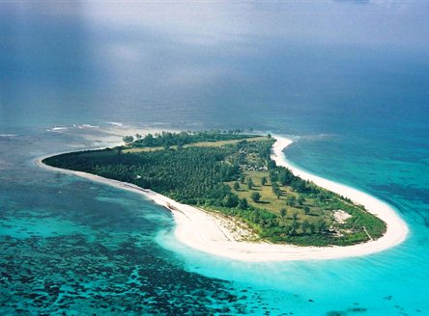
Zone E Multi-Use Zone: Tourism, Culture and Recreation
Primary objective: allocate space to maximise opportunities for tourism, recreation and appreciation of culture.
Targeted Uses: Coastal accommodation, fishing: recreation and sport, public recreation, Seychelles culture, tourism
Potential future uses: To Be Determined
Considerations:
Licenses and tenures
Locals vs. visitors
Recreation and sports fishing
Photo: JustSeychelles.com
Photo: Frontiers Travel

Slide 15
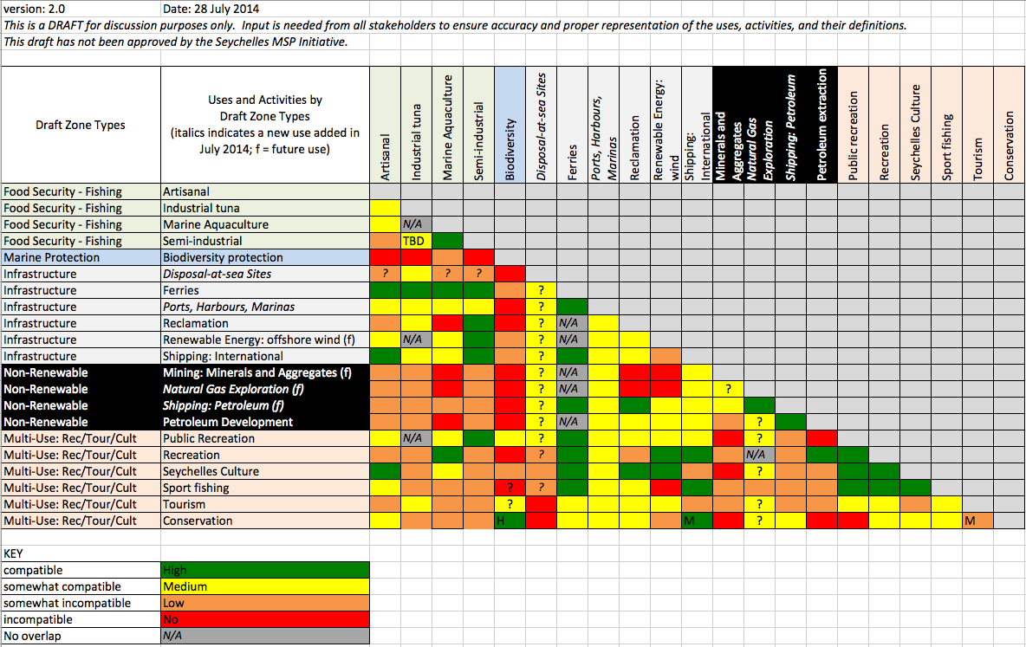
Zone design - > “map”
Non-overlapping zones
Consider intensity and frequency of uses
Compatible uses – matrix

Slide 16
Summary
Used input from Stakeholder Workshops #1 and #2
Review of available data and information
Review and advice from Technical Working Group
Existing and potential future activities considered
Practical, innovative, and flexible approach
Zone types based on 5 primary objectives:
Zone A – Food Security – Fishing
Zone B – Marine Protected Area Zone – Biodiversity
Zone C – Infrastructure & Services
Zone D – Non-Renewable Development
Zone E – Multi-Use Zone: Tourism, Recreation, Culture

Slide 17
Questions and Discussion

Slide 18
Implement Zoning
Considerations:
Governance
Financing
Monitoring and evaluation
Capacity to implement zones: capacity needs assessment

Slide 19
Challenges
Technical, legal and political complexities
Competing interests and conflicting values
Long timelines for formalising
Zoning a dynamic, 3-dimensional ecosystem
Property rights and ownership discussions

Slide 20
“Good practices” for zoning
Set clear objectives for zoning
Clearly differentiate zone types
Build on existing zoning efforts
Respect existing laws and regulations
Weigh simplicity against complexity
Educate and inform people → build buy in

Slide 21
DRAFT Zoning Objectives
Reduce spatial conflicts among uses
Identifying management directions for all uses
Provide overall guidance for resource managers - business certainty and business efficiency
Identify areas for enhanced management for cultural, ecological, and social objectives

Slide 22
Ways to Approach Zoning
Uses
Ecology
Objectives

Slide 23
Uses
Examine historic patterns and status quo
Dominant use is featured or named
Identify single or multiple uses – “Tourism Zone” or “Multi-Use Zone”
Need excellent spatial data for mapping
Can be hard to fit in future uses

Slide 24
Ecology
Relative ecological importance
Allocate intensive uses in impacted areas
Uses transition and buffers

Slide 25
Objectives
Determine highest or best use
Use broad or descriptive divisions
Provisions allow or preclude uses
Flexible for future activities
Emphasises the objective for the zone

Slide 26
Zoning Approach
Can be used if data are not available for all uses
Considers both existing and future activities
Clearly emphasises the purpose or objective
Broad zone types can include many activities
Develop multiple objective zoning in short time frame
Notes:
The proposed zoning approach for the Seychelles is to use "objective" based zoning (see Section 2). This approach is proposed for several reasons. Firstly, a use-based or ecologically-based approach both require quite a lot of data in order to delineate zones. At this point in the planning process, data layers for uses and activities are sparse thus it is not possible to allocate space based on specific uses. Secondly, the goal of the plan is for existing and future uses. By using a zoning approach that is flexible enough to include existing uses and possible future uses, zoning will be able to adapt over time. Finally, an objective-based approach clearly emphasises or identifies to the marine users, public, and resource managers the purpose of the zone. Management, enforcement and regulation of the zone can be mandated by the objective rather than be individual uses.

Slide 27
DRAFT Zoning Scheme for Seychelles
5 Zones
5 Objectives
Integrated
Comprehensive
Multi-sector approach- includes all uses
Innovative - capture emerging opportunities
Practical - business certainty for existing uses
Flexible – uncertainty, future activities, climate change
Considers advice from workshop #2 (May 2014)
Considers lessons learned globally on governance, MSP implementation, and conservation
Notes:
The zone types were developed after careful consideration of advice from workshop #2, marine plans around the world, the challenges in implementation and governance, lessons learned from other processes, emerging economic opportunities, climate change, conservation, and balancing innovation with practicality.

Slide 28
Compatibility Matrix

