Slide 1
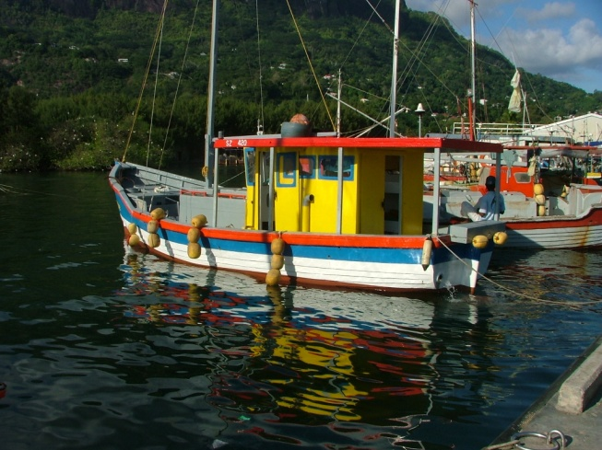
Zoning Design
Seychelles Marine Spatial Planning Initiative
22 October 2014
Technical Working Group Meeting #2

Slide 2
Rules to Guide Zoning Design
Represent current uses
Identify the “best areas” for a use
Identify conflicts and compatibilities
Represent values for uses, methodology could include:
Set representation goals
Set distance targets.
Stratify spatially:
Plateau
Offshore

Slide 3
Zoning Design Tools
Use systematic planning tools - Marxan - to optimise solutions based on representation goals
Hand-drawn solutions using visual inspection and a range of information

Slide 4
Challenges
Identify “best areas” for uses
Representing values

Slide 5
Questions

