Slide 1
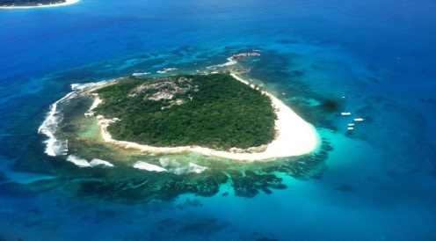
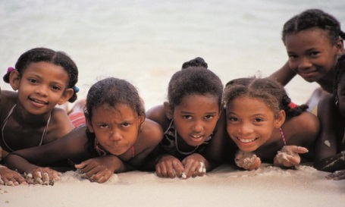
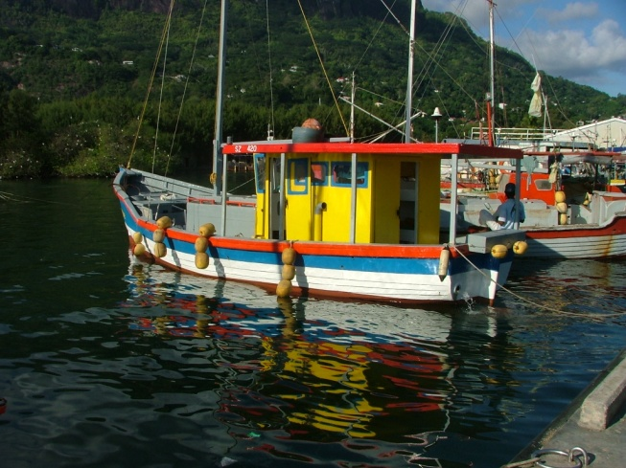
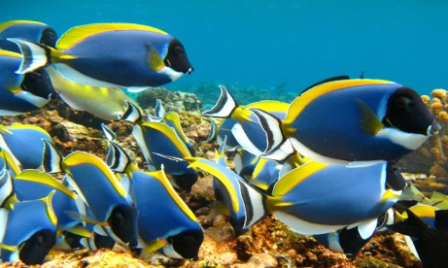
Participatory Mapping 1 August 2014
Seychelles Marine Spatial Planning Initiative
22 October 2014
Technical Working Group Meeting #2

Slide 2
Sketches from Break-out Groups
Map Code | Zone Group | Description | Sector + Compatibility or Conflict | Location
1 | A | Artisanal fishing and biodiversity (MPA) | Fishing and Biodiversity (MPAs) | Cerf and Sainte Anne
2 | A | Artisanal fishing and biodiversity (MPA) | Fishing and Biodiversity (MPAs) | Curieuse
3 | A | MPA and no subsistence fishing | Fishing and Biodiversity | Praslin
4 | A | Artisanal fishing, diving and shark fishing | Fishing & Tourism | Marianne
5 | A | Artisanal fishing - High Priority Area | Fishing | NW Mahe Plateau - north half
6 | A | Artisanal fishing - High Priority Area - potential Oil & Gas conflict | Fisheries & Oil, Gas | SE Mahe Plateau - south half
7 | A | No fishing conflict with other uses | No conflict with Fishing | East central Mahe Plateau
8 | B | Conflict with industrial fishing on seamounts | Fishing & Biodiversity | SE Desroches - seamounts
9 | B | Sand mining | Biodiversity & Mining | NW Mahe, offshore Beau Vallon
10 | B | 99, 116, 132 Infrastructure, Emirates Hotel | Biodiversity & Tourism | Baie Ternay Marine National Park
11 | B | 99, 116 132, Policy Bay marina development | Biodiversity & Tourism | South end Mahe
12 | B | 99, 116, 132 Proposed Marina | Biodiversity & Tourism | Sainte Anne
13 | B | 199, 116, 132 Reclamation | Biodiversity & Tourism | Beau Vallon
14 | B | Tourism operator attracting sharks to diving area | Biodiversity & Tourism | Sainte Anne
15 | D | Sand mining Priority Area | Mining | NW Mahe, offshore Beau Vallon
16 | B | 45, 46, 47 Mariculture | Biodiversity & Mariculture | Praslin
17 | B | 90 Shipping Impacts | Biodiversity & Shipping | Sainte Anne
18 | B | Artisanal fishing in marine parks | Biodiversity & Fishing | Cerf and Ste Anne
19 | B | Reclamation potential almost everywhere | Biodiversity & Development | Victoria & vicinity
20 | B | 96 Jet ski areas | Biodiversity & Tourism/Recreation | Victoria & NE shore
21 | B | Opportunistic dredging | Biodiversity & Development | NW Mahe, offshore Beau Vallon
22 | B | Biodiversity High Priority Area - High endemism | Biodiversity | North of Denis, offshore
23 | C | Ballast water from ships | Shipping

Slide 3
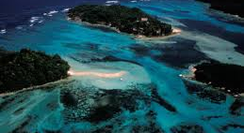
Questions

