Slide 1
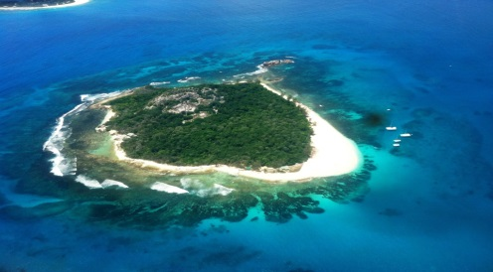
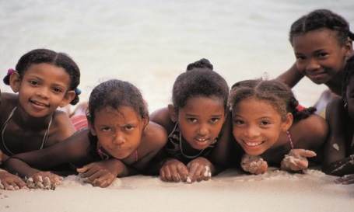
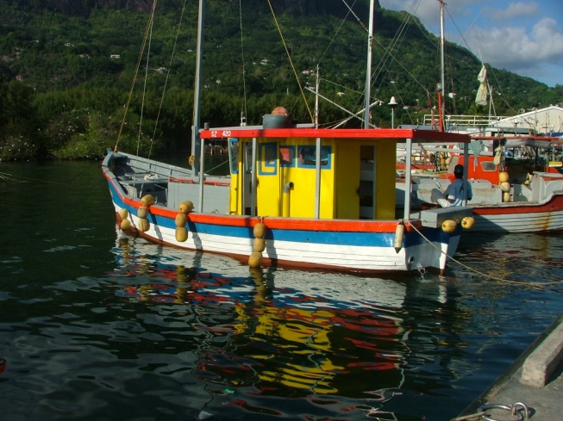
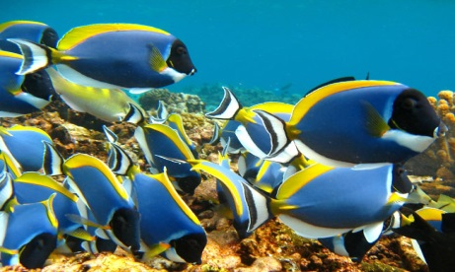
Decision-making
Seychelles Marine Spatial Planning Initiative
22 October 2014
Technical Working Group Meeting #2

Slide 2
Decision-making for uses within a Zone
Can use a decision-making matrix to guide decisions for allowing or not allowing uses
Identify attributes for the Zone
Identify other uses that may occur now and in the future, and rank level of impact on the attribute
1) Access
2) Individual-level effects for species
3) Population-level effects
3) Habitat disturbance, alteration, destruction
4) Ecosystem Integrity alteration or change

Slide 3
Decision-making Inputs
List of attributes
Value ranking for each Attribute
List of possible uses
Ranking for effect of uses in relation to the attribute(s)

Slide 4
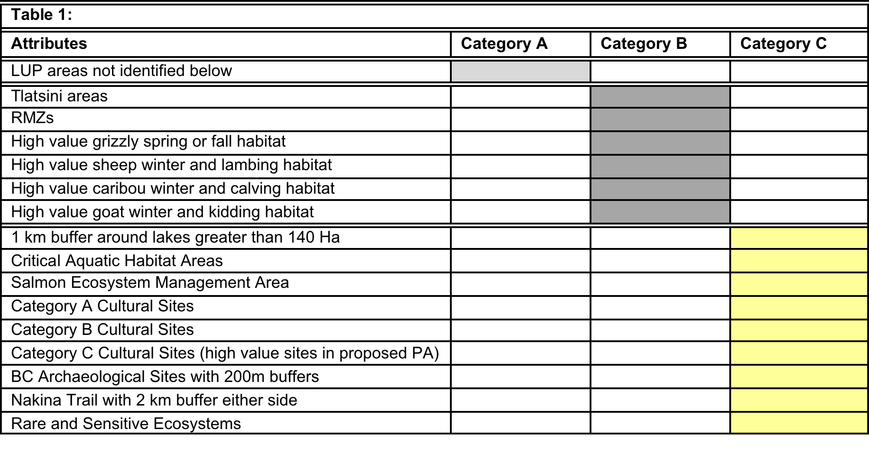
Sample Attribute Table
(British Columbia)
Source: Atlin-Taku Planning Area

Slide 5
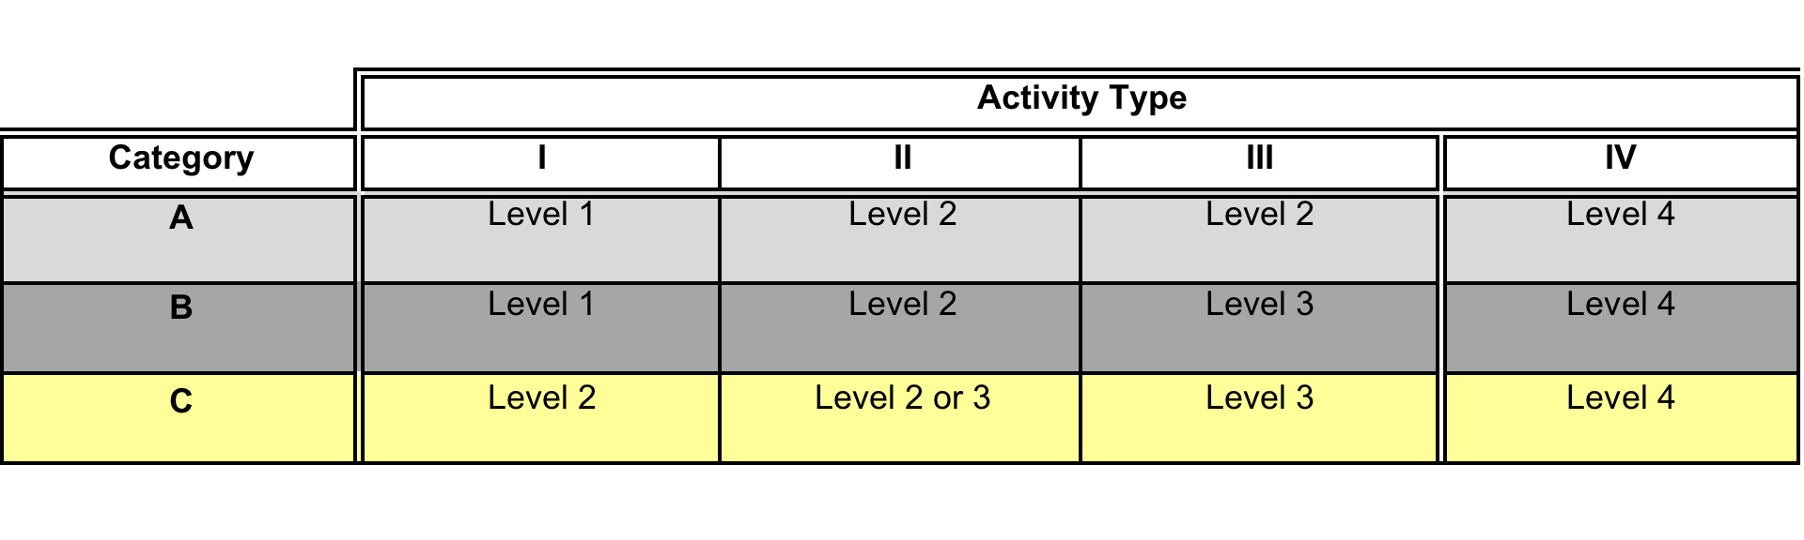
Consultation Matrix for Activities based on Biodiversity and Cultural Values
LOW: Level 1 engagement involves notification only.
MED: Level 2 engagement involves discussions between Provincial and First Nation technical staff, with support from the Engagement Coordinators.
HIGH: Level 3 engagement involves a Joint Technical Meeting of the relevant BC and Tlingit technical staff, with support from the Engagement Coordinators.
Agreed timelines for engagement at these various levels are set out in the BC-TRT Agreement on Land and Resource Management.
Source: Atlin-Taku Planning Area

Slide 6
